Slide 1






PRESENTATION 2026
[From Raw Data to Revenue Insights: A Sales Intelligence Project using Excel and AI]
Mentor Name
Student Name
Student Email
Anshika Sisodiya
sisodiyaaashi82@gmail.com
Umamaheswari

Slide 2

Outline
Abstract of the Project
Problem Statement
Proposed Solution
System Architecture
Live Demo of the Project
Embedded Video of Project
Conclusion
Future Scope

Slide 3

Abstract
This project analyzes a structured sales dataset to generate business insights and support data-driven decision-making. It focuses on understanding sales performance, identifying trends, and solving problems related to forecasting, demand, and pricing.
The project uses Microsoft Excel for analysis and dashboard creation, along with Power Bi for AI-assisted insights.
The outcome is an interactive dashboard with key insights and recommendations to improve sales and profitability

Slide 4

Problem Statement
Businesses fail to effectively analyze product quantity (bquantity) data, leading to issues like overstocking and stock shortages.
Traditional manual analysis and lack of interactive dashboards prevent identification of demand patterns and quantity trends.
There is a growing need for data-driven solutions to analyze product quantity (bquantity) trends, as poor insights lead to inefficient inventory planning and inaccurate demand forecasting.
Existing methods rely on basic Excel analysis of historical data, lacking interactive dashboards and advanced insights, which limits effective decision-making using tools like Excel and Power BI.

Slide 5

Proposed Solution
To address inefficiencies in inventory and demand planning, this solution enables businesses to leverage data-driven analysis of product quantity (bquantity) for smarter decision-making. By transforming raw sales data into meaningful insights, it helps identify demand patterns, optimize stock levels, and reduce losses caused by overstocking and stockouts.
Using tools like Excel, Power BI the solution provides interactive dashboards and AI-assisted insights that allow managers to monitor quantity trends, forecast demand more accurately, and make timely, informed business decisions.

Slide 6
System Architecture
Data Input / Source
Processing / Analysis
The project uses a structured sales dataset in Excel format (Kaggle-style), based on raw transaction data. All analysis is performed within Microsoft Excel, with no external APIs or databases used.
Data is cleaned, transformed with new fields, and analyzed using pivots and charts to identify key trends and insights.
AI / Tool Integration
Output / Dashboard
Excel is used for data cleaning, analysis, and dashboard creation, while Copilot is used to generate insights and summaries for better decision-making.
The final output is an interactive dashboard with charts and KPI indicators, along with a structured report highlighting key insights and business recommendations.

Slide 7
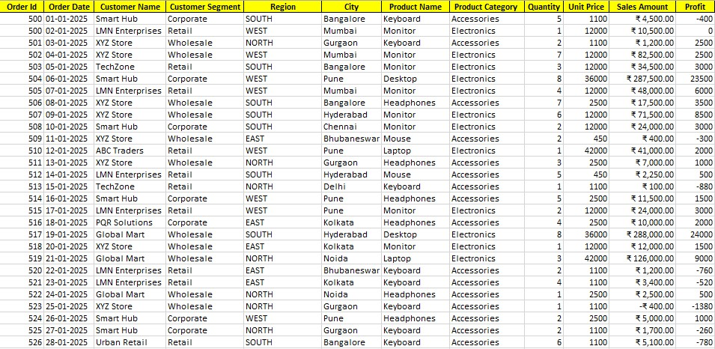
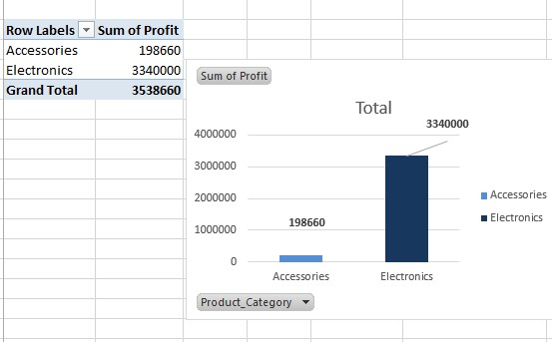
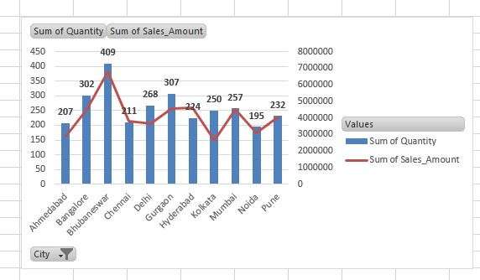
Live Demo of Project
Here's the list of some demo screenshots / features of the project:
Demo 2
Demo 3
Demo 1
Profit Distribution by Product Category”
Cleaned and Structured Sales Dataset
Profit Distribution by Product Category
Sales and Quantity Analysis by City

Slide 8
Video of Project Demo
https://drive.google.com/file/d/1aR5gof0prZLoANNr8FZAgapVhTpYmOrT/view?usp=drivesdk
▶
[Insert your project demo video.
You can embed a video your live project.]

Slide 9

Conclusion
This project successfully transformed raw sales data into meaningful insights using Microsoft Excel and Power Bi Key findings include identification of sales trends, top-performing regions, and profitability patterns.
The objectives of data analysis, visualization, and insight generation were achieved through an interactive dashboard. The project adds value by enabling data-driven decision-making, improved forecasting, and better business strategy planning.
CONCLUSION

Slide 10

Future Scope
This project can be further enhanced by integrating real-time data sources and expanding the dataset for large-scale analysis. Advanced forecasting techniques and machine learning models can be applied to improve prediction accuracy.
The dashboard can be upgraded using tools like Power BI for better scalability and visualization. Integration with business systems (ERP/CRM) can enable automated data updates and decision-making.
Additionally, deeper AI integration using ChatGpt can provide more advanced insights and recommendations, increasing the overall impact of the project.

Slide 11
Thank You
AICW Fellowship | Student Project Presentation 2026
LinkedIn | Edunet Foundation

